Slide 1

Linked Lists
Creative Commons Attribution-NonCommercial-ShareAlike 3.0 Unported License. http://creativecommons.org/licenses/by-nc-sa/3.0/
Written by Rachel J. Morris, last updated 2016-09-17

Slide 2
Linked Lists
Linked Lists are a type of data structure that is implemented differently than the static and dynamic arrays that we've worked with so far.
Data
* Next
Data
* Next
Data
* Next
NULL
But they still allow us to work with
a sequence of data.
(Not all data structures keep its data sequential!)

Slide 3
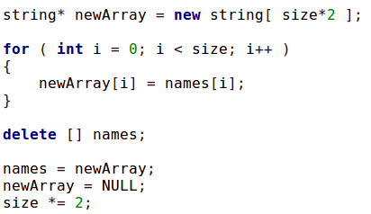
A Con of Dynamic Arrays...
One of the problems of dynamic arrays is that, once you run out of memory, you have to spend processing time creating a new array, copying over the old array, and freeing the memory.
If your array is storing a lot of large data, or is pretty big, this could mean a noticeable performance hit.

Slide 4

Add & remove memory as-needed?
Wouldn't it be nice to have a structure that adds memory as-needed, a little bit at a time, so that we don't have this bottleneck?

Slide 5
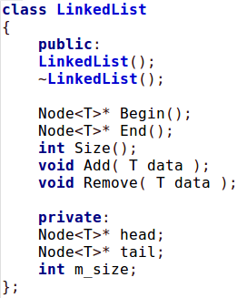
The two parts of a Linked List
When programming a Linked List, there are two parts to it:
The first part is the List class itself, which contains functions to add, remove, and other useful helper-functions.
but rather than it storing an array of items internally, it only stores pointers - usually to the very first and very last thing in the list.

Slide 6
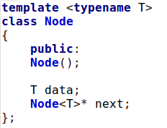
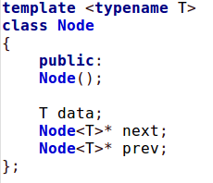
The two parts of a Linked List
When programming a Linked List, there are two parts to it:
The second part of a Linked List is the
data wrapper; a class that wraps the data.
We create a Node object, which stores the data, but also stores a pointer to the next item in the list (and sometimes the previous item.)

Slide 7
The two parts of a Linked List
When programming a Linked List, there are two parts to it:
A Node could be a class or a struct, and can contain more information than this
but this is a pretty common node and similar to what you would see in many implementations.

Slide 8
Pros and Cons of a Linked List
Pros
Cons
Avoid the stop-and-resize processing time like with a dynamic array
Insertion and Deletion is cheap and easy - just moving pointers around!
Stacks and Queues can be implemented easily with a Linked List
No random-access like with arrays: Have to traverse the list to get a specific element (Sequential access)
More memory is needed due to next/prev pointers (vs. no pointers in an array)
Other
Elements of the list don't have to be in contiguous memory spaces like with an array.

Slide 9
Why else is a Linked List useful?
We can use a Linked List class to implement a
Stack and Queue data structure...
Stack
Push
Pop
3
3
2
2
2
2
1
1
1
1
1
1
A Stack is a first-in, last-out structure.
You’re only able to access the top-most item of the Stack.

Slide 10
Why else is a Linked List useful?
We can use a Linked List class to implement a
Stack and Queue data structure...
Queue
Push
Pop
1
1
2
1
2
3
1
2
3
2
3
3
A Queue is a first-in, first-out structure.
You’re only able to access the front-most item of the Queue.

Slide 11
Implementation

Slide 12
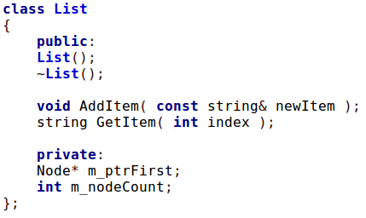
Allocating memory as-needed
Let's assume we have the following List class written:

Slide 13

Allocating memory as-needed
Adding the First Element:
When we go to add our first element of the list:
1. initialize m_ptrFirst as a new Node instance
2. Set m_ptrFirst’s data value to the new item being passed in.
3. If it isn’t nullptr already, set its ptrNext to nullptr.
(And add 1 to m_nodeCount)

Slide 14
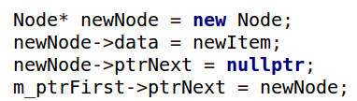
Allocating memory as-needed
Adding the Second Element:
Then, the next time we go to add something, it will now be the second element in the list.
We can't just overwrite m_ptrFirst, but we can create a new node - which is the one it is pointing to with ptrNext:
Create a new node
Set its data and next ptr
Point the first node’s next ptr to this new node.
But we can’t hard-code this logic; we have to generalize.

Slide 15
Pseudocode: Adding an item
Logic behind adding a new item:
Add new data "d" to the list. (Function begin)
Is this the first item to be added to the list?
  YES:
    Instantiate our first-element Node pointer as a new item.
    Set its data to "d"
    Add 1 to the Node Count
  NO:
    Get the end of the list (ptrTail*?)
    Create and instantiate a new Node* item.
    Set the new item's data to "d".
    For the last element of the list, set its new "ptrNext" pointer to the new Node that we made.
    Add 1 to the Node Count
ptrFirst
New Node!
New
Node!
ptrLast
next
New ptrLast
(This assumes that Node’s constructor sets ptrNext to nullptr!)

Slide 16

Removing an item
When removing an item from a Linked List,
you could have a version that passes in an index,
or a version that passes in the data that is stored.
If an index is passed in, you’ll have to traverse the list while counting what position you’re at.
If a value is passed in, you’ll still have to traverse the list, but don’t have to count the position.
Depending on if your Node stores only the next ptr or both next and prev ptrs, the implementation might change...

Slide 17
Removing an item
When we’re removing an item from the list, we need to keep track of:
a. The previous node (so we can close the gap)
b. The node we’re removing
List
ptrFirst
C
A
ptrNext
B
ptrNext
ptrNext
D

Slide 18
Removing an item
When we’re removing an item from the list, we need to keep track of:
a. The previous node (so we can close the gap)
b. The node we’re removing
List
ptrFirst
C
A
ptrNext
B
ptrNext
ptrNext
D
Save what B’s ptrNext is pointing at
&
Remove B

Slide 19
Removing an item
When we’re removing an item from the list, we need to keep track of:
a. The previous node (so we can close the gap)
b. The node we’re removing
List
ptrFirst
C
A
ptrNext
ptrNext
ptrNext
D
Need to update the pointers!

Slide 20
Removing an item
When we’re removing an item from the list, we need to keep track of:
a. The previous node (so we can close the gap)
b. The node we’re removing
List
ptrFirst
C
A
ptrNext
ptrNext
D
Previous node’s
PtrNext is now
“C”

Slide 21
Removing an item
If you have a doubly linked list, the Nodes are pointing to both the next node and the
previous node. This makes the removal easier.
List
ptrFirst
C
A
ptrNext
ptrNext
ptrNext
B
ptrPrev
D
ptrPrev
ptrPrev

Slide 22
Removing an item
If you have a doubly linked list, the Nodes are pointing to both the next node and the
previous node. This makes the removal easier.
List
ptrFirst
ptrNext
C
A
ptrNext
ptrPrev
ptrPrev
D
B

Slide 23
Implement in code...

